Slide 1
“The Back-Up Plan”
Study of Acts 1-3

Slide 2
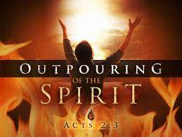

Slide 3
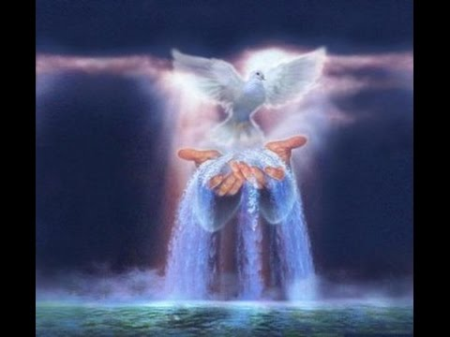
Before they were baptized by the Holy Spirit
Acts 2:1 “when the day of Pentecost had fully come, they were all with one accord in one place.”

Slide 4
One Accord = one mind and heart, complete unity,
Acts 1:14 “these all continued with one accord in prayer and supplication, with the women and Mary the mother of Jesus, and with His brothers.”
One Place = due to the command of Jesus to wait for the promised of the Father (Acts 1:4)

Slide 5
Acts 2:3 “then there appeared to them divided tongues, as of fire, and one sat upon each of them.”
Acts 2:4 “and they were all filled with the Holy Spirit and began to speak in other tongues, as the Spirit gave them utterance.”

Slide 6
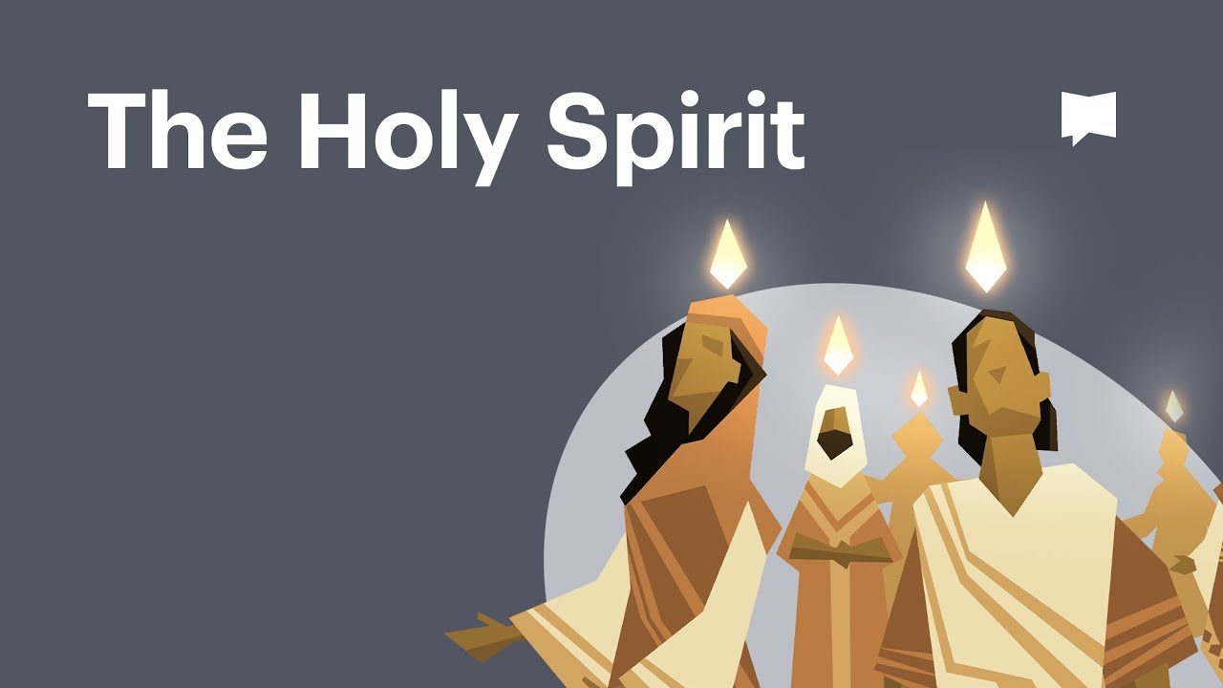

Slide 7
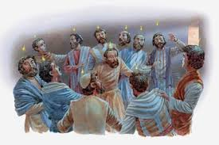

Slide 8
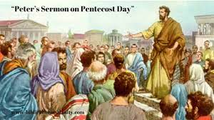

Slide 9
Gawa 2:37 “Nang marinig nila ito ay nasaktan ang kanilang mga puso, at sinabi kay Pedro at sa iba pang mga apostol, mga kapatid, anong gagawin namin?”

Slide 10
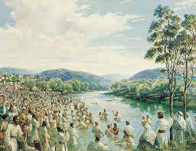
Gawa 2:38 “at sinabi sa kanila ni Pedro, mangagsisi kayo, at mangagbautismo ang bawat isa sa inyo sa pangalan ni Jesucristo sa ikapagpapatawad ng inyong mga kasalanan; at tatanggapin ninyo ang kaloob ng Espiritu Santo”

Slide 11
OUR PRESENT CONDITION

Slide 12
I saw that many do not realize what they must be in order to live in the sight of the Lord without a high priest in the sanctuary through the time of trouble.
Those who receive the seal of the living God and are protected in the time of trouble must reflect the image of Jesus fully. EW p.71.1

Slide 13
I saw that many were neglecting the preparation so needful and were looking to the time of “refreshing” and the “latter rain” to fit them to stand in the day of the Lord and to live in His sight.

Slide 14
Oh, how many I saw in the time of trouble without a shelter! They had neglected the needful preparation; therefore they could not receive the refreshing that all must have to fit them to live in the sight of the holy God. EW p.71.2

Slide 15
The Lord has rich blessings for the church if its members will seek earnestly to arouse from this perilous lukewarmness. A religion of vanity, words devoid of vitality, a character destitute of moral strength, - these are pointed out in the solemn message addressed by the True Witness to the churches, warning them against pride, worldliness, formalism, and self-sufficiency. 5T p. 484.2

Slide 16
The End-Time Back-up Plan

Slide 17
Acts 3: 19 “repent therefore and be converted, that your sins may be blotted out, so the times of refreshing may come from the presence of the Lord.”

Slide 18
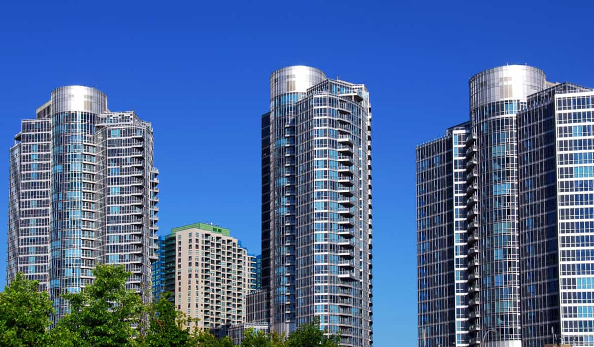
1 John 2:15,16 “Do not love the world or the things in the world. If anyone loves the world, the love of the Father is not in him. For all that is in the world– lust of the flesh, the lust of the eyes, and the pried of life—is not of the Father but is of the world.”

Slide 19
Luke 21:34 “datapuwa’t mangag-ingat kayo sa inyong sarili, baka mangalugmok ang inyong mga puso sa kalayawan, at sa kalasingan, at sa mga pagsusumakit ukol sa buhay na ito, at dumating na bigla sa inyo ang araw na yaon na gaya ng silo.”

Slide 20
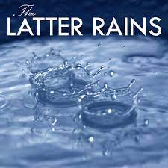
Zechariah 10:1 “Ask the Lord for the rain in the time of the latter rain. The Lord will make flashing clouds; He will give them showers of rain, grass in the field for everyone.”

Slide 21
The Promised Revival for the Common People
Gawa 2:17 “At mangyayari sa mga huling araw, sabi ng Dios, na ibubuhos Ko ang Aking Espiritu sa lahat ng laman: atang inyong mga anak na lalake at babae ay manganghuhula, at ang inyong mga binata ay mangakakakita ng mga pangitain, ang inyon mga matatanda ay magsisipanaginip ng mga panaginip.”

Slide 22
The work will be similar to that of the Day of Pentecost. As the “former rain” was given, in the outpouring of the Holy Spirit at the opening of the gospel, to cause the upspringing of the precious seed, so the “latter rain” will be given at its close for the ripening of the harvest.” GC p.611.2

Slide 23
The apostles performed miracles and wonders during the time of Pentecost:
Healed those that were sick even with just the shadow of Peter (Acts 5:15,16)
Made the lame walk (Acts 3:6)
Even made the dead back to life as the case of Eutychus (Acts 20:8,9)

Slide 24
Imagine what the Holy Spirit can do to your life in the power of the Latter Rain….
Let’s make it possible by submitting our lives completely to God starting today…

