Slide 1
Revival & Reformation
the FINAL STRETCH towards CHRIST’S SECOND COMING!

Slide 2
Changing our conditions
Rev. 3:14-18
¹⁴ “To the angel of the church in Laodicea write:
These are the words of the Amen, the faithful and true witness, the ruler of God’s creation. ¹⁵ I know your deeds, that you are neither cold nor hot. I wish you were either one or the other! ¹⁶ So, because you are lukewarm—neither hot nor cold—I am about to spit you out of my mouth.

Slide 3
¹⁷ You say, ‘I am rich; I have acquired wealth and do not need a thing.’ But you do not realize that you are wretched, pitiful, poor, blind and naked. ¹⁸ I counsel you to buy from me gold refined in the fire, so you can become rich; and white clothes to wear, so you can cover your shameful nakedness; and salve to put on your eyes, so you can see.

Slide 4
Introduction
1846 – there were only 50 SABBATH KEEPERS
1863 – when the Church was started, there were only 3,500 members and all of them lived in the United States.
As of 12/31/07, Seventh-day Adventist are established in 201 of the 230 Countries

Slide 5
As of today
237 countries of the world recognized by UN
215 countries and areas of the world in which Seventh-day Adventist work is established
92, 186 churches
72,749 companies
More than 25 million members
19,717 pastors

Slide 6
But then the People of God have overcome with pleasures, worldliness, pride and other abominable things…. up to this time!!!

Slide 7
What must be done to finish the Work?

Slide 8
“A REVIVAL OF TRUE GODLINESS AMONG US IS THE GREATEST AND MOST URGENT OF ALL OUR NEEDS. TO SEEK THIS SHOULD BE OUR FIRST WORK.” 1 SM p. 121
WHY?

Slide 9
Revival & Reformation
“God calls for a Spiritual Revival and a Spiritual Reformation. Unless this takes place, those who are lukewarm will continue to grow more abhorrent to the Lord, until He will refuse to acknowledge them as His Children. A Revival and Reformation must take place, under the ministration of the Holy Spirit.”

Slide 10
What is REVIVAL?
Revival signifies a renewal of spiritual life, a quickening of the powers of mind and heart, a resurrection from spiritual death.”

Slide 11
What is reformation
Reformation signifies a REORGANIZATION, a change in IDEAS and THEORIES, HABITS and PRACTICES.”

Slide 12
REFORMATION will not bring forth the good fruit of righteousness unless it is connected with the revival of the spirit. Revival and Reformation are to do their appointed work, and in doing this work they must blend.”
1 SM p. 128

Slide 13
A View of the condition of our church found in Rev. 3:14-18
Lukewarm- walang sigla, maligamgam
Wretched- kaawa-awa
Miserable- mahirap, masama
Poor- aba
Blind- bulag
Naked- hubad
“The message to the Laodecean church reveals our condition as a people.”
R&H, Dec. 15, 1904

Slide 14
Ellen White’s view of the Church
“God’s people must take warning and discern the signs of the times. The signs of Christ’s Coming are TOO PLAIN to be doubted; and in view of these things everyone who professes the truth should be a living preacher. God calls upon all, both preachers and people to be awake. All heaven is astir. The scenes of earth’s peril is before us, and yet we are not awake. This lack of activity and earnestness in the cause of God is dreadful. This death stupor is from Satan…

Slide 15
Unbelief, like the pall of death, is surrounding our churches, because they do not exercise the talents God has given them, by imparting the light to those who know not the precious truth. Satan is now seeking to hold God’s people in a state of inactivity… Men are in peril. Multitudes are perishing. But how few of the professed followers of Christ are burdened for these souls.

Slide 16
There is a stupor, a paralysis, upon the people of God, which prevents them from understanding the duty of the hour. Satan uses listless, sleepy indolence of professed Christians to strengthen his forces and win souls to his side…

Slide 17
Satanic Death Stupor Continues
…When I study the Scriptures, I am alarmed of the Israel of God in these last days. They are exhorted to flee from idolatry. I feel that they are asleep, and so conformed to the world that it would be difficult to discern between him that serve God and him that serve Him not. The distance is widening between Christ and His people, and lessening between them and the world.

Slide 18
The mark of distinction between Christ’s professed people and the world have almost disappeared. Like ancient Israel, they followed the abominations of the nations around them.
Christian Service, p. 37,38

Slide 19
Satan’s very last Deception
“Satan is… constantly pressing the spurious – to lead away from the truth. The very last deception of Satan will be to make of none effect the TESTIMONY of the Spirit of God. “Where there is no vision, the people perish” (Prov. 29:18). Satan will work ingeniously, in different ways and through different agencies, to unsettled the confidence of God’s remnant people in the TRUE TESTIMONY. Letter 12, 1890” SM vol.1,p.48

Slide 20
Revelation 14:6-10
And I saw another angel flying in the midst of heaven, having the everlasting gospel to preach unto them that dwell on the earth, to every nation and kindred, and tongue, and people, saying with a loud voice, FEAR GOD and GIVE GLORY TO HIM; for THE HOUR OF HIS JUDGMENT HAS COME; and WORSHIP HIM that made the heaven, and earth, and the sea, and the fountains of water. V.6,7

Slide 21
And there followed another angel, saying Babylon is fallen, is fallen, that great city, because she made all nations drink of the wrath of her fornication. V.8
And the third angel followed them, saying with a loud voice, If any man worship the beast and his image, and receive his mark on his forehead, or in his hand, the same shall drink of the wine of the wrath of God, which is poured out without mixture into the cup of his indignation. V.9,10

Slide 22
WHO WILL BE ABLE TO STAND? WHO will proclaim the Messages?
WILL YOU?
WILL I?

Slide 23
“In the last solemn work few great men will be engaged.” They are self-sufficient, independent of God, and He cannot use them. The Lord has faithful servants, who in the shaking, testing time will be disclosed to view. There are precious ones now hidden who have not bowed knee to Baal. They have not had the light which has been shining in a concentrated blaze upon you. But it may be under a rough and uninviting exterior the pure brightness of a genuine Christian character will be revealed.” Testimonies vol.5 p.80

Slide 24
“When trees without fruit are cut down as cumberers of the ground, when multitudes of false brethren are distinguished from the true, then THE HIDDEN ONES will be revealed to view, and with hosannas range under the banner of Christ. Those who have been timid and self-distrustful will declare themselves openly for Christ and His truth. The most weak and hesitating in the church will be as David– willing to do and dare. Testimonies vol. 5 p.81

Slide 25
WHAT ARE THE REQUIREMENTS?
“the third angel’s message is to lighten the earth with its glory; but only those who withstood the temptation in the strength of THE MIGHT ONE will be permitted to act a part in proclaiming it when it shall have swelled into the LOUD CRY”—Review & Herald Nov. 19, 1908 par.9

Slide 26
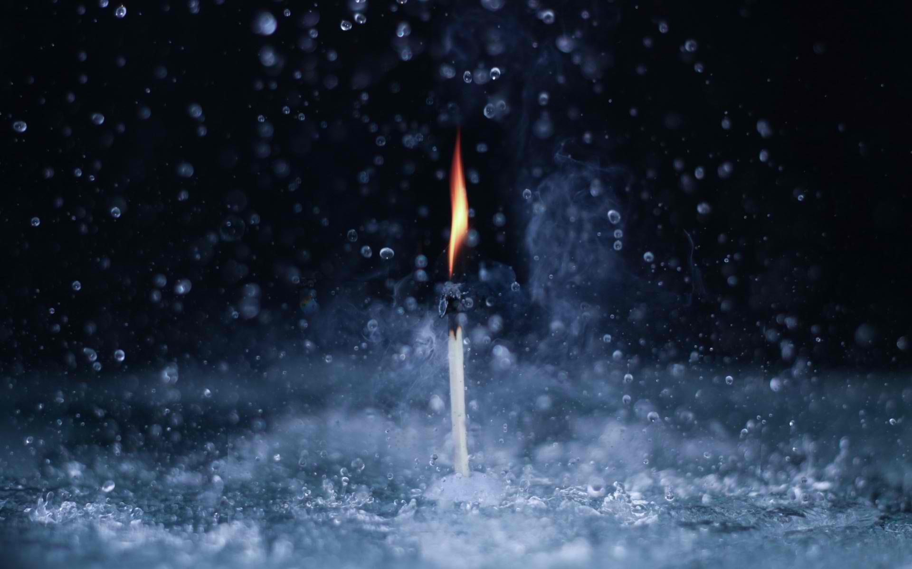
THE LATTER RAIN IS COMING!!!

Slide 27
The Promise of the Early and the Latter Rain
“Be patient therefore, brethren, unto the coming of the Lord. Behold, the husbandman waits for the precious fruit of the earth, and had long patient for it, until he receive the early and the latter rain. Be ye also patient; establish your hearts, for the coming of the Lord draweth nigh.” James 5:7,8

Slide 28
THE LATTER RAIN WHAT DOES IT REPRESENT?
“the OUTPOURING OF THE SPIRIT is liken to the falling of the latter rain; and it is for this added power that Christians are to send their petitions to the Lord of the harvest in the time of the latter rain.
Acts of the Apostles p.55 par.1

Slide 29
LATTER RAIN WHO WILL RECEIVE IT?
“It is God who began the work, and He will finish His work, making man complete in Jesus Christ. But there must be no neglect of the grace represented by the FORMER RAIN. Only those who are living up to the LIGHT they have will receive the GREATER LIGHT. Unless we are daily advancing in the exemplification of the daily Christian virtues, we shall not recognize the manifestations of the Holy Spirit in the Latter Rain. It may be falling in the hearts all around us, but we shall not discern or receive it.”– Testimonies to Ministers p. 507.1

Slide 30
THE WORK NEEDED TO RECEIVE THE LATTER RAIN
“it was by the confession and forsaking of sin, by earnest prayer and by consecration of themselves to God, that the early disciples prepared for the outpouring of the Holy Spirit on the day of Pentecost. The same work, only in greater degree, must be done now, then the human agent had only to ask for the blessing, and wait for the Lord to perfect the work concerning him.” Testimonies to Minister p. 507 par. 1

Slide 31
WHO WILL BE FOUND STRIVING TO OVERCOME SIN TODAY?

Slide 32
THE FORMER RAIN IS ALREADY FALLING!
“Quench not the Spirit. Despise not Prophesying. Prove all things; Hold fast that which is good.” 1 Thess. 5:19-21

